Slide 1


Chapter 4
Induction and Recursion
Discrete Mathematics
and Its Applications
Sixth Edition
By Kenneth Rosen
歐亞書局

Slide 2
4.1 Mathematical Induction
4.2 Strong Induction and Well-
Ordering
4.3 Recursive Definitions and
Structural Induction
4.4 Recursive Algorithms
4.5 Program Correctness
歐亞書局
P. 1

Slide 3
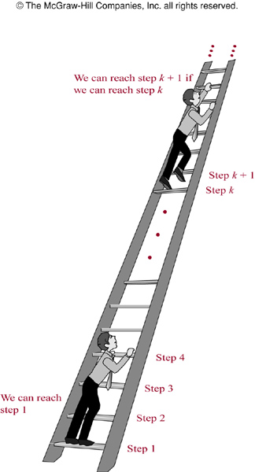
FIGURE 1 (4.1)
FIGURE 1
Climbing and Infinite Ladder.
歐亞書局
P. 264
Notes:
p:\msoffice\My Projects\Rosen 6e 2007\Imagebank\JPEGs07-24-06\ch04\jpeg\04_1_01.jpg

Slide 4
4.1 Mathematical Induction
Principle of Mathematical Induction:
to prove that P(n) is true for all positive integers n, where P(n) is a propositional function
  Basis step: P(1) is true
  Inductive step: P(k) → P(k+1) is true for all positive integers k
    Inductive hypothesis: P(k) is true
[P(1)∧∀k(P(k)→P(k+1))] → ∀nP(n)

Slide 5
Ways to Remember How Mathematical Induction Works
E.g.
  Climbing an infinite ladder
  People telling secrets
  Infinite row of dominoes

Slide 6
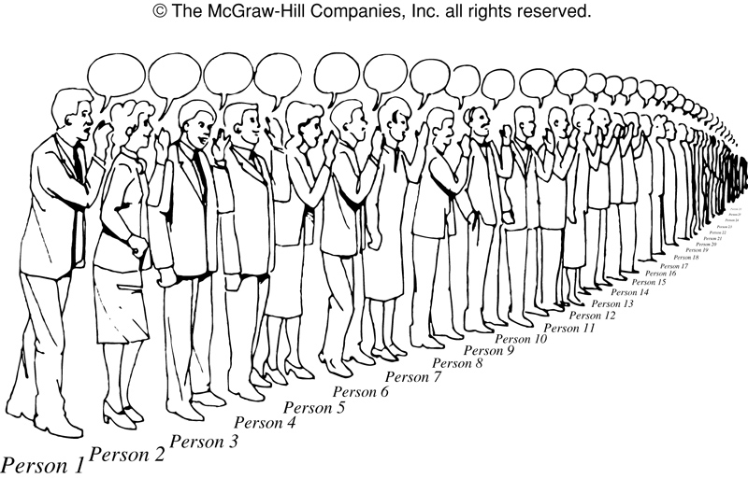
FIGURE 2 (4.1)
FIGURE 2 People Telling Secrets.
歐亞書局
P. 266
Notes:
p:\msoffice\My Projects\Rosen 6e 2007\Imagebank\JPEGs07-24-06\ch04\jpeg\04_1_02.jpg

Slide 7
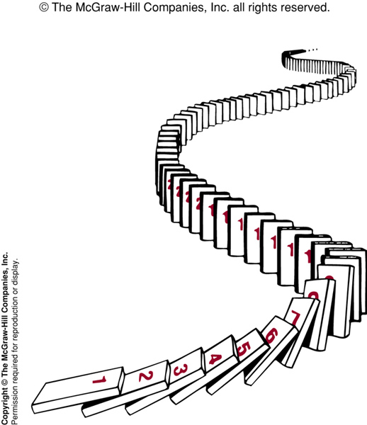
FIGURE 3 (4.1)
FIGURE 3 Illustrating How Mathematical Induction Works Using Dominoes.
歐亞書局
P. 266
Notes:
p:\msoffice\My Projects\Rosen 6e 2007\Imagebank\JPEGs07-24-06\ch04\jpeg\04_1_03.jpg

Slide 8
Examples of Proofs by Mathematical Induction
Proving summation formulae
  Ex.1-4
Proving inequalities
  Ex.5-7
Proving divisibility results
  Ex.8
Proving results about sets
  Ex.9-10
Proving results about algorithms
  Ex.11
Creative uses of mathematical induction
  Ex.12-13

Slide 9
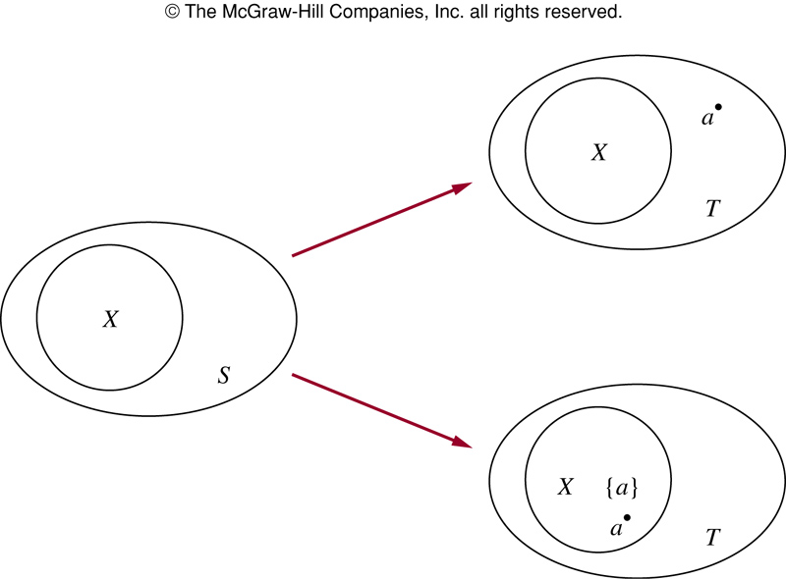
FIGURE 4 (4.1)
FIGURE 4 Generating Subsets of a Set with k+1 Elements. Here T = S∪{a}.
歐亞書局
P. 274
Notes:
p:\msoffice\My Projects\Rosen 6e 2007\Imagebank\JPEGs07-24-06\ch04\jpeg\04_1_04.jpg

Slide 10

FIGURE 5 (4.1)
FIGURE 5 A Right Triomino.
歐亞書局
P. 277
Notes:
p:\msoffice\My Projects\Rosen 6e 2007\Imagebank\JPEGs07-24-06\ch04\jpeg\04_1_05.jpg

Slide 11

FIGURE 6 (4.1)
FIGURE 6 Tiling 2 × 2 Checkerboards with One Square Removed.
歐亞書局
P. 277
Notes:
p:\msoffice\My Projects\Rosen 6e 2007\Imagebank\JPEGs07-24-06\ch04\jpeg\04_1_06.jpg

Slide 12
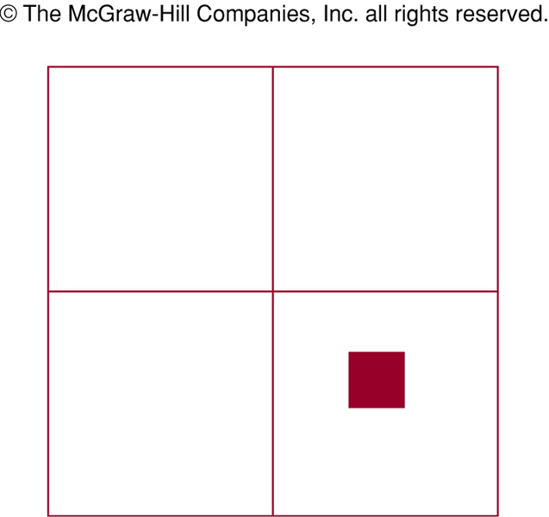
FIGURE 7 (4.1)
FIGURE 7 Dividing a 2^{k+1} × 2^{k+1} Checkerboard into Four 2^{k} × 2^{k} Checkerboards.
歐亞書局
P. 278
Notes:
p:\msoffice\My Projects\Rosen 6e 2007\Imagebank\JPEGs07-24-06\ch04\jpeg\04_1_07.jpg

Slide 13

FIGURE 8 (4.1)
FIGURE 8 Tiling the 2^{k+1} × 2^{k+1} Checkerboard with One Square Removed.
歐亞書局
P. 278
Notes:
p:\msoffice\My Projects\Rosen 6e 2007\Imagebank\JPEGs07-24-06\ch04\jpeg\04_1_08.jpg

Slide 14
Why Mathematical Induction is Valid
The Well-Ordering Property (Appendix 1)
  Every nonempty subset of the set of positive integers has a least element.
(proof by contradiction)
Errors in proofs using mathematical induction
  Ex.14: What’s wrong in the “proof”?

Slide 15
4.2 Strong Induction and Well-Ordering
Strong induction
  Basis step: P(1) is true
  Inductive step: [P(1)∧P(2)∧…∧P(k)] → P(k+1) is true for all positive integers k
    Inductive hypothesis: P(j) is true for j=1,2,…,k
    More flexible
Mathematical induction, strong induction, well-ordering: equivalent principles
  Strong induction: second principle of mathematical induction, or complete induction

Slide 16
Examples of Proofs Using Strong Induction
Some clues of how to decide which method to use
  Use mathematical induction when it’s straightforward to prove that P(k)→P(k+1) is true for all positive integers
  Use strong induction when you see how to prove that P(k+1) is true from the assumption that P(j) is true for all positive integers j not exceeding k
  Ex.2-5

Slide 17
Using Strong Induction in Computational Geometry
Polygon
  Side
  Vertex
  Diagonal
Simple polygon: no two nonconsecutive sides intersect
Convex polygon: every line segment connecting two points in the interior of the polygon lies entirely inside the polygon
Triangulation

Slide 18
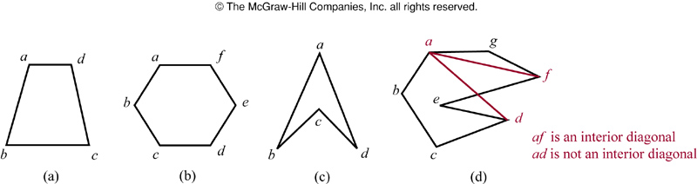
FIGURE 1 (4.2)
FIGURE 1 Convex and Nonconvex Polygons.
歐亞書局
P. 288
Notes:
p:\msoffice\My Projects\Rosen 6e 2007\Imagebank\JPEGs07-24-06\ch04\jpeg\04_2_01.jpg

Slide 19
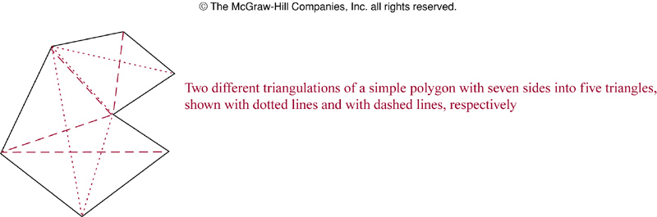
FIGURE 2 (4.2)
FIGURE 2 Triangulations of a Polygon.
歐亞書局
P. 289
Notes:
p:\msoffice\My Projects\Rosen 6e 2007\Imagebank\JPEGs07-24-06\ch04\jpeg\04_2_02.jpg

Slide 20
Theorem 1: A simple polygon with n sides, where n is an integer with n>=3, can be triangulated into n-2 triangles.
  Proof:
Lemma 1: Every simple polygon has an interior diagonal.
  Proof:

Slide 21
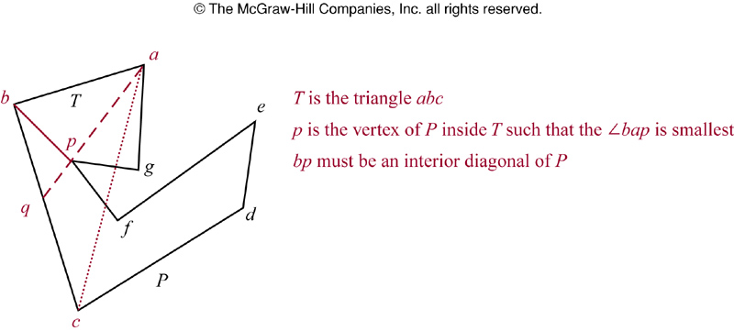
FIGURE 3 (4.2)
FIGURE 3 Constructing and Interior Diagonal of a Simple Polygon.
歐亞書局
P. 290
Notes:
p:\msoffice\My Projects\Rosen 6e 2007\Imagebank\JPEGs07-24-06\ch04\jpeg\04_2_03.jpg

Slide 22
4.3 Recursive Definitions and Structural Induction
Recursively defined functions
  Basis step: specify the value of the function at zero
  Recursive step: give a rule for finding its value at an integer from its values as its domain
Ex. Recursive or inductive definition
  f(0)=3
  f(n+1)=2f(n)+3
  Find f(1), f(2), f(3), f(4).

Slide 23
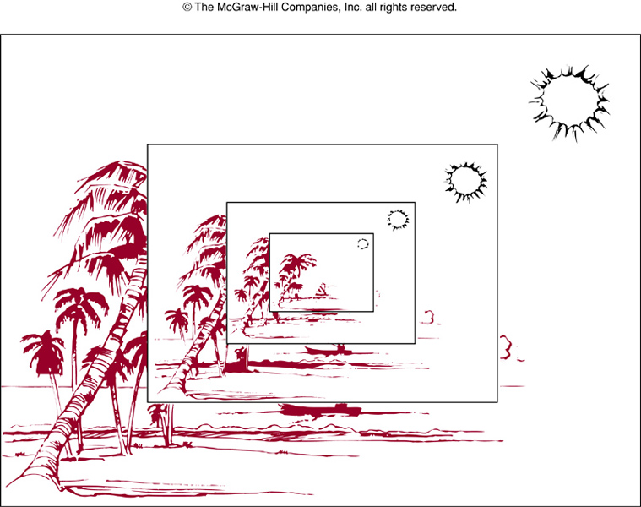
FIGURE 1 (4.3)
FIGURE 1 A Recursively Defined Picture.
歐亞書局
P. 295
Notes:
p:\msoffice\My Projects\Rosen 6e 2007\Imagebank\JPEGs07-24-06\ch04\jpeg\04_3_01.jpg

Slide 24
More examples
  F(n)=n!
  a^{n}
Definition 1: The Fibonacci numbers, f₀, f₁, f₂, … , are defined by the equations f₀=0, f₁ =1, and f_{n}= f_{n-1} + f_{n-2} for n=2, 3, 4, ….
Ex.6: Show that whenever n>=3, f_{n} >α^{n-2}, where α=(1+√5)/2.

Slide 25
Theorem 1: (Lamé’s Theorem) Let a and b be positive integers with a>=b. Then the number of divisions used by the Euclidean algorithm to find gcd(a,b) is less than or equal to five times the number of decimal digits in b.
  Proof

Slide 26
Recursively Defined Sets and Structures
Basis step
Recursive step
Exclusion rule
Ex.7:
  Basis step: 3∈S
  Recursive step: if x∈S and y∈S, then x+y∈S.

Slide 27
Definition 2: The set Σ* of strings over the alphabet Σ can be defined recursively by
basis step: λ∈Σ* (λ: empty string)
recursive step: if w∈Σ* and x∈Σ, then wx∈ Σ*.
  Ex.8: Σ={0,1}

Slide 28
Definition 3: Two strings can be combined via the operation of concatenation(⋅).
  Basis step: if w∈Σ*, then w⋅λ=w.
  Recursive step: if w₁∈Σ* and w₂∈Σ* and x∈Σ, then w₁⋅(w₂x)= (w₁⋅w₂)x.
Ex.9: length of a string
Ex.10: well-formed formulae for compound statement forms
Ex.11: well-formed formulae for operators and operands

Slide 29
Definition 4: The set of rooted trees can be defined recursively by these steps:
  Basis step: a single vertex is a rooted tree.
  Recursive step: suppose T₁, …, T_{n} are disjoint rooted trees with roots r₁, …, r_{n}. Then the graph formed by starting with a root r, which is not in any of the rooted trees T₁, …, T_{n} , and adding an edge from r to each of the vertices r₁, …, r_{n}, is also a rooted tree.

Slide 30
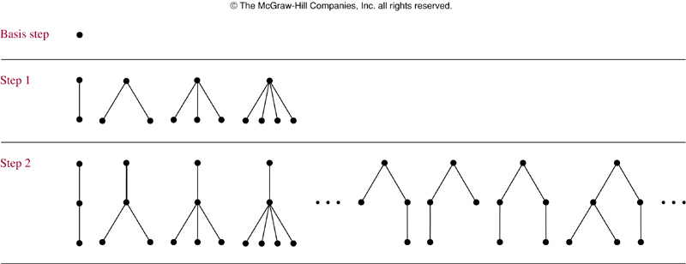
FIGURE 2 (4.3)
FIGURE 2 Building Up Rooted Trees.
歐亞書局
P. 302
Notes:
p:\msoffice\My Projects\Rosen 6e 2007\Imagebank\JPEGs07-24-06\ch04\jpeg\04_3_02.jpg

Slide 31
Definition 5: The set of extended binary trees can be defined recursively by these steps:
  Basis step: the empty set is an extended binary tree.
  Recursive step: If T₁ and T₂ are disjoint extended binary trees, there is an extended binary tree, denoted by T₁⋅T₂, consisting of a root r, together with edges from r to each of the roots of the left subtree T₁ and the right subtree T₂ when these trees are nonempty.

Slide 32
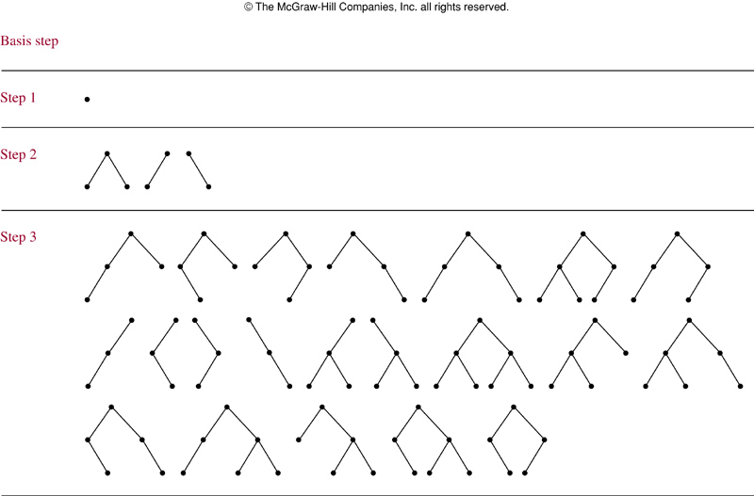
FIGURE 3 (4.3)
FIGURE 3 Building Up Extended Binary Trees.
歐亞書局
P. 303
Notes:
p:\msoffice\My Projects\Rosen 6e 2007\Imagebank\JPEGs07-24-06\ch04\jpeg\04_3_03.jpg

Slide 33
Definition 6: The set of full binary trees can be defined recursively by these steps:
  Basis step: There is a full binary tree consisting only of a single vertex r.
  Recursive step: If T₁ and T₂ are disjoint full binary trees, there is a full binary tree, denoted by T₁⋅T₂, consisting of a root r, together with edges from r to each of the roots of the left subtree T₁ and the right subtree T₂.

Slide 34
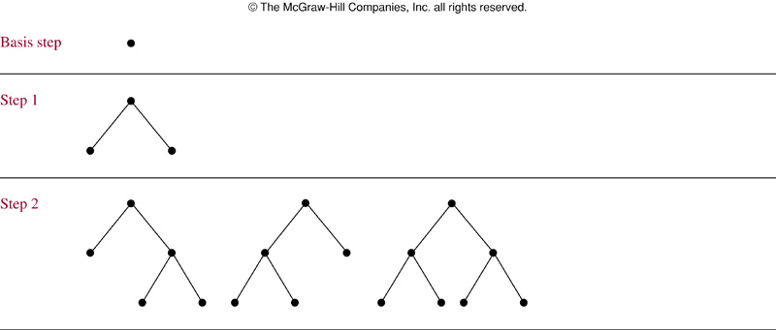
FIGURE 4 (4.3)
FIGURE 4 Building Up Full Binary Trees.
歐亞書局
P. 304
Notes:
p:\msoffice\My Projects\Rosen 6e 2007\Imagebank\JPEGs07-24-06\ch04\jpeg\04_3_04.jpg

Slide 35
Structural Induction
Basis step: show that the result holds for all elements in the basis step of the recursive definition.
Recursive step: show that if the statement is true for each of the elements used to construct new elements in the recursive step of the definition, the result holds for these new elements.
Ex.12
Ex.13
Ex.14

Slide 36
Definition 7: We define the height h(T) of a full binary tree T recursively.
  Basis step: the height of the full binary tree T consisting of only a root r is h(T)=0.
  Recursive step: if T₁ and T₂ are full binary trees, then the full binary tree T= T₁⋅T₂ has height h(T)=1+max(h(T₁),h(T₂)).
Theorem 2: If T is a full binary tree T, then n(T)<=2^{h(T)+1}-1.

Slide 37
Generalized Induction
To prove results about other sets that have the well-ordering property besides the set of integers
(more details in Sec.8.6)

Slide 38
4.4 Recursive Algorithms
Definition 1: An algorithm is called recursive if it solves a problem by reducing it to an instance of the same problem with smaller input.
Ex.1: n!
Ex.2: a^{n}
Ex.3: b^{n} mod m
Ex.4: gcd(a, b)
Ex.5: linear search
Ex.6: binary search

Slide 39
Algorithm 1: A recursive algorithm for computing n!
  Procedure factorial(n: nonnegative integer)
  if n=0 then factorial(n):=1
  else factorial(n):=n*factorial(n-1)
Algorithm 2: A recursive algorithm for computing an
  Procedure power(a, n)
  if n=0 then power(a,n):=1
  else power(a,n):=a*power(a,n-1)

Slide 40
Algorithm 3: Recursive modular exponentiation
  Procedure mpower(b, n, m)
  if n=0 then mpower(b,n,m)=1
  else if n is even then mpower(b,n,m)=mpower(b,n/2,m)² mod m
  else mpower(b,n,m)=(mpower(b,n/2,m)² mod m * b mod m) mod m
Algorithm 4: a recursive algorithm for computing gcd(a,b)
  Procedure gcd(a,b: nonnegative integers, a<b)
  if a=0 then gcd(a,b):=b
  else gcd(a,b):=gcd(b mod a, a)

Slide 41
Algorithm 5: a recursive linear search algorithm
  Procedure search(i, j, x)
  if ai=x then location:=i
  else if i=j then location:=0
  else search(i+1, j, x)
Algorithm 6: a recursive binary search algorithm
  Procedure binary search(i, j, x)
  m:=⎣ (i+j)/2⎦
  if x=am then location:=m
  else if (x<am and i<m) then binary search(i, m-1, x)
  else if (x>am and j>m) then binary search(m+1, j, x)
  else location:=0

Slide 42
Proving Recursive Algorithms Correct
By using mathematical induction or strong induction
Ex.7: prove that algorithm 2 is correct.
Ex.8: prove that algorithm 3 is correct.

Slide 43
Recursion and Iteration
Recursion: reducing computation to the evaluation of the function at smaller integers
Iteration: start with the base cases, and apply recursive definition to find the value of the function at larger integers
  Usually requires much less computation

Slide 44
Algorithm 7: a recursive algorithm for Fibonacci numbers
  Procedure fibonacci(n: nonnegative integer)
  if n=0 then fibonacci(0):=0
  else if n=1 then fibonacci(1):=1
  else fibonacci(n):=fibonacci(n-1)+fibonacci(n-2)
  f_{n+1}-1 additions

Slide 45
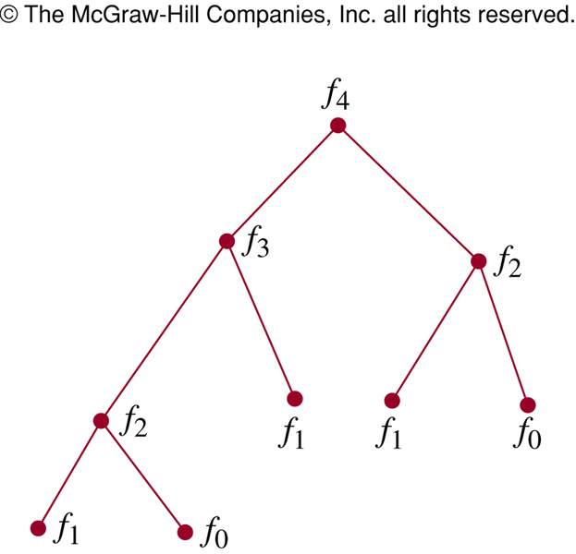
FIGURE 1 (4.4)
FIGURE 1 Evaluating f₄ Recursively.
歐亞書局
P. 316
Notes:
p:\msoffice\My Projects\Rosen 6e 2007\Imagebank\JPEGs07-24-06\ch04\jpeg\04_4_01.jpg

Slide 46
Algorithm 8: an iterative algorithm for computing fibonacci numbers
  Procedure iterative fibonacci(n: nonnegative integer)
  if n=0 then y:=0
  else
  begin
  x:=0
  y:=1
  for i:=1 to n-1
  begin
  z:=x+y
  x:=y
  y:=z
  end
  end
  n-1 additions

Slide 47
The Merge Sort
Algorithm 9: A recursive merge sort
  Procedure mergesort(L=a₁, …, a_{n})
  if n>1 then
  m:=⎣n/2⎦
  L1:=a₁,a₂,…a_{m}
  L2:=a_{m+1},a_{m+2},…,a_{n}
  L:=merge(mergesort(L1),mergesort(L2))

Slide 48
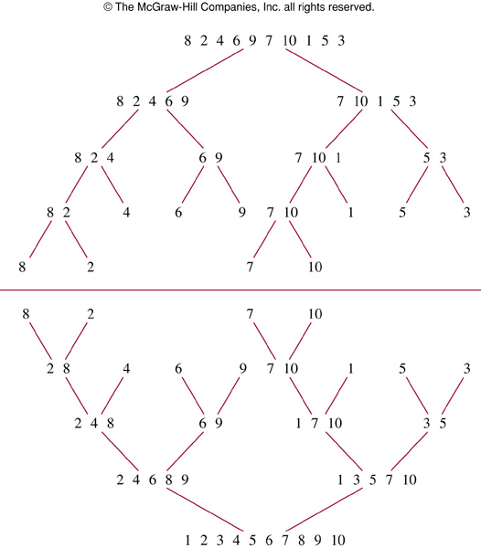
FIGURE 2 (4.4)
FIGURE 2 The Merge Sort of 8,2,4,6,9,7,10,1,5,3.
歐亞書局
P. 318
Notes:
p:\msoffice\My Projects\Rosen 6e 2007\Imagebank\JPEGs07-24-06\ch04\jpeg\04_4_02.jpg

Slide 49
Algorithm 10: Merging Two Lists
  Procedure merge(L1, L2:sorted lists)
  L:=empty list
  while L1 and L2 are both nonempty
  begin
  remove smaller of first element of L1 and L2 and put at the right end of L
  if removal of this element makes one list empty
  then remove all elements from the other list and append them to L
  end
(Ex.10)

Slide 50
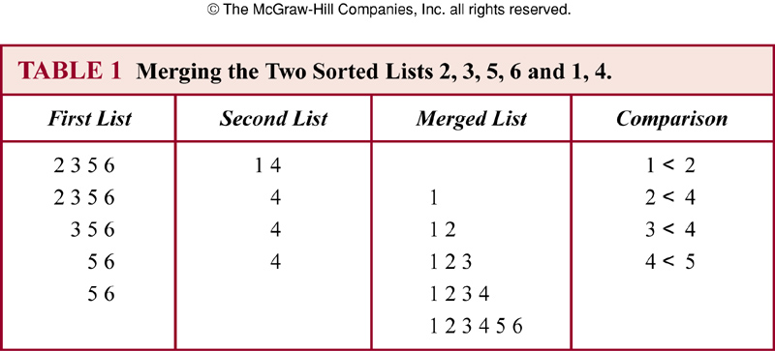
TABLE 1 (4.4)
歐亞書局
P. 319
Notes:
p:\msoffice\My Projects\Rosen 6e 2007\Imagebank\JPEGs07-24-06\ch04\jpeg\t04_4_01.jpg

Slide 51
Lemma 1: Two sorted lists with m elements and n elements can be merged into a sorted list using no more than m+n-1 comparisons.
Theorem 1: The number of comparisons needed to merge sort a list with n elements is O(nlogn)

Slide 52
Thanks for Your Attention!

